Slide 1

A markov random fields approach to the gating of flow cytometry data
Kevin Brosnan, University of Limerick

Slide 2
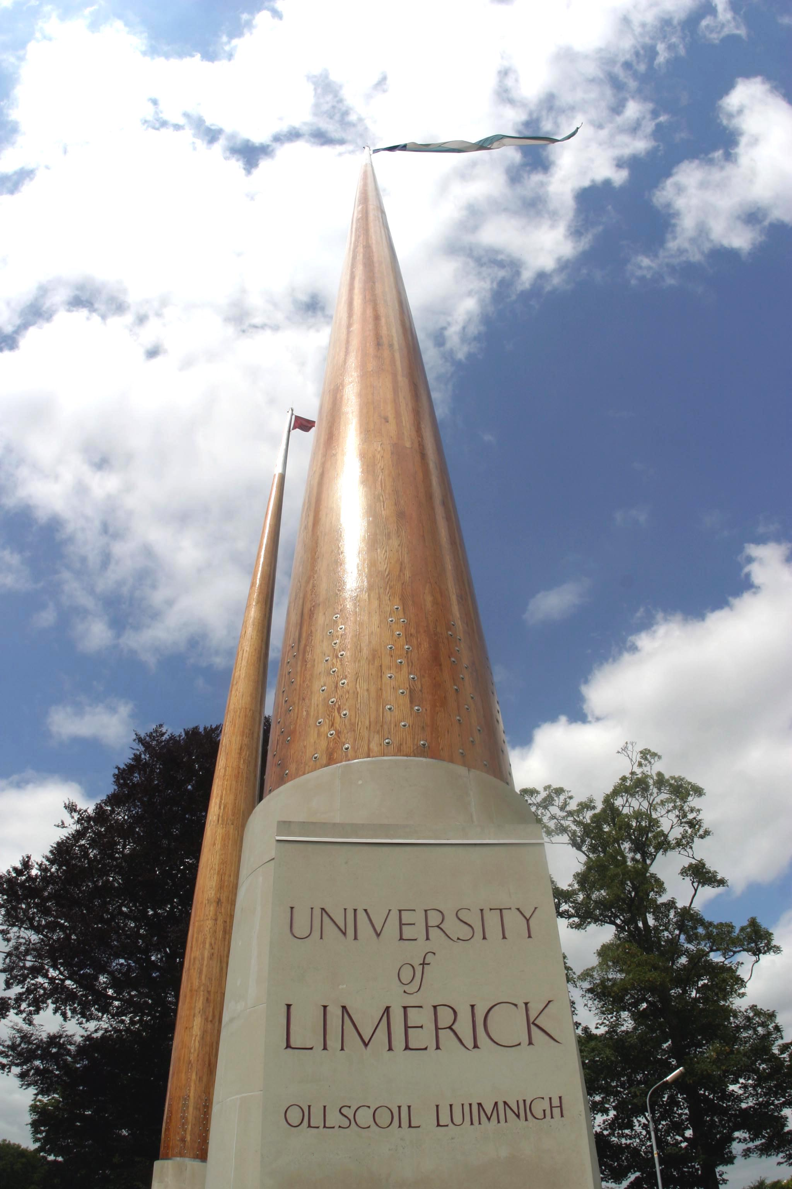

Presentation
outline
Flow Cytometry
Existing methods
Markov Random Fields
Identifying Clusters
Results
Further Work

Slide 3
Flow cytometry…

Slide 4
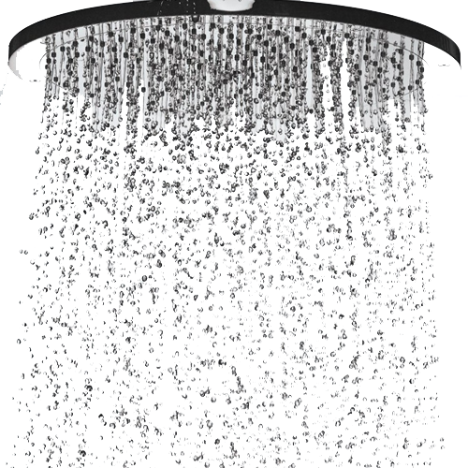


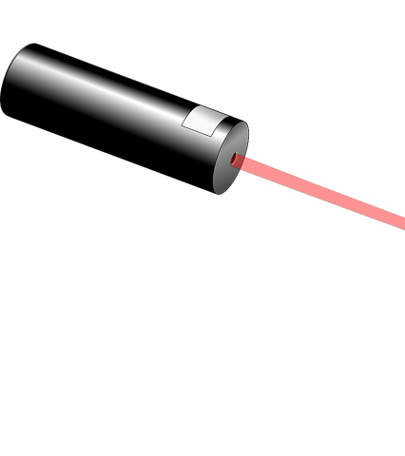



What is flow cytometry?
metry
Cyto
Flow
Notes:
I want something like the image of the light passing through a shower with a cell in it onto a white screen

Slide 5
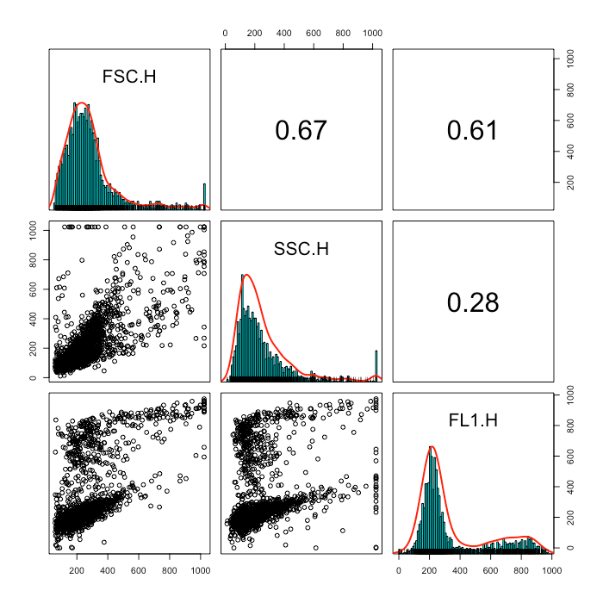
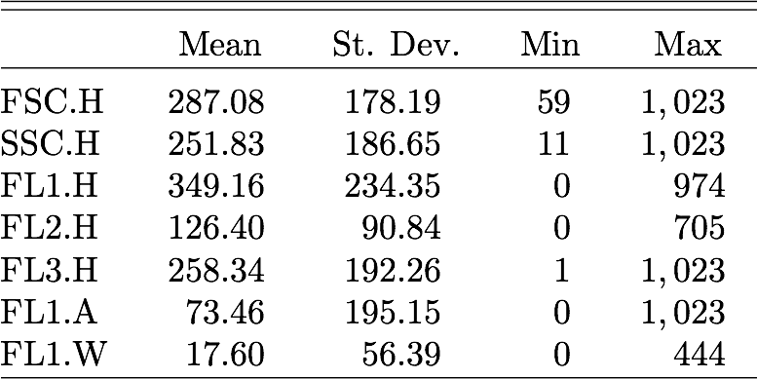
Flow cytometry data…
Notes:
I need to come up with something clever here to show the data

Slide 6
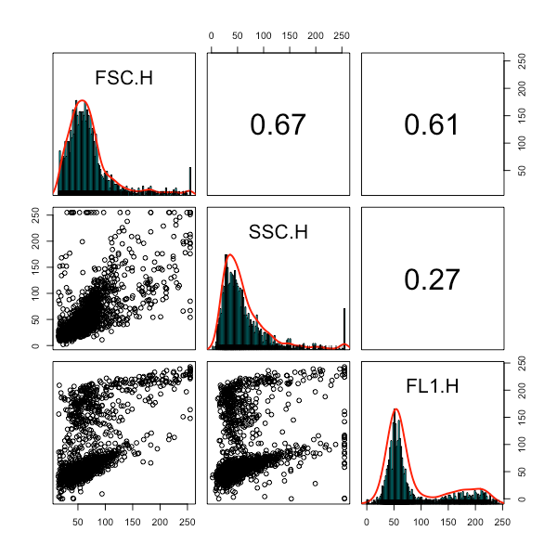
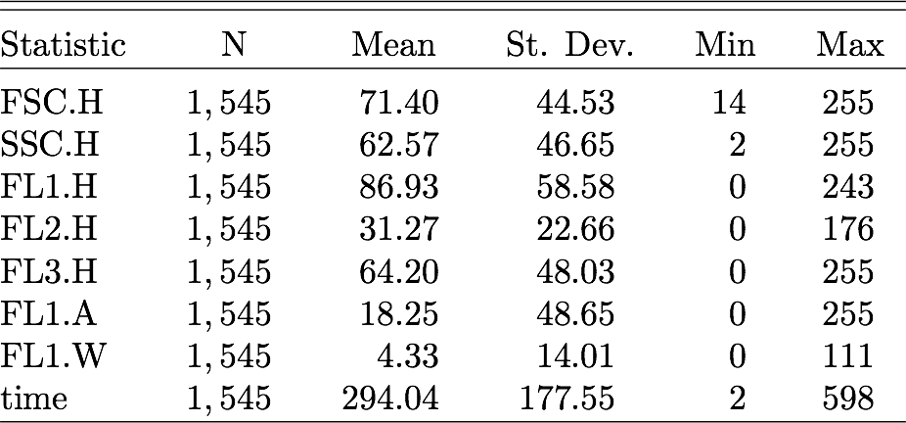
Sparsity…
Notes:
I need to come up with something clever here to show the data

Slide 7
Existing methods…

Slide 8
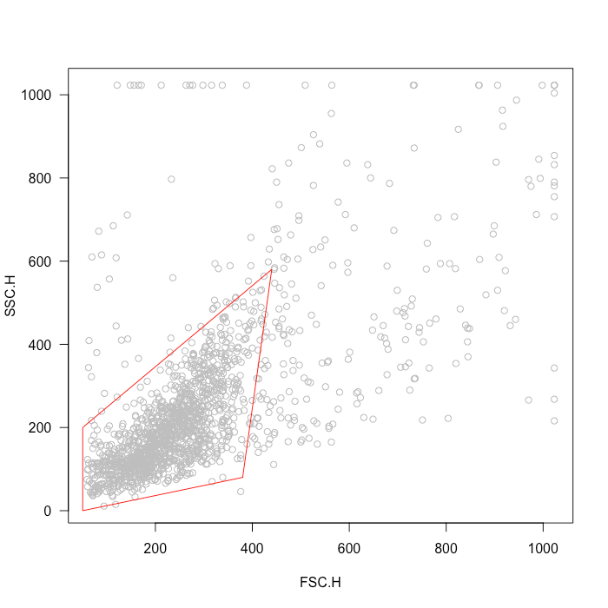
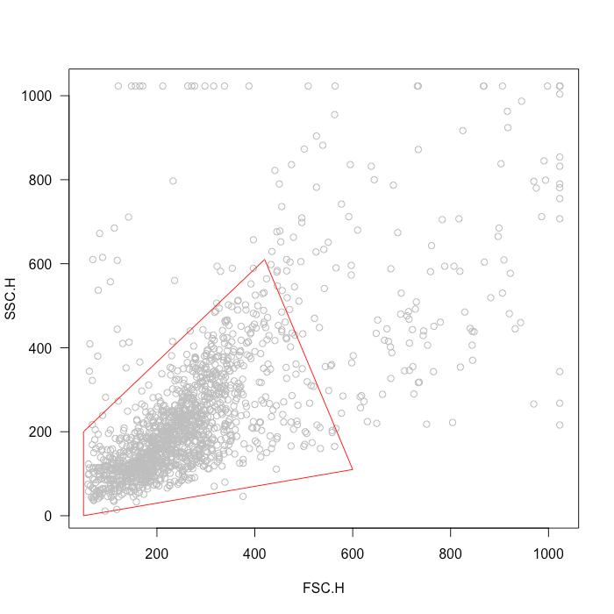
Industry Standard…
Expert 1
Expert 2
Notes:
Picture of two different experts drawings

Slide 9
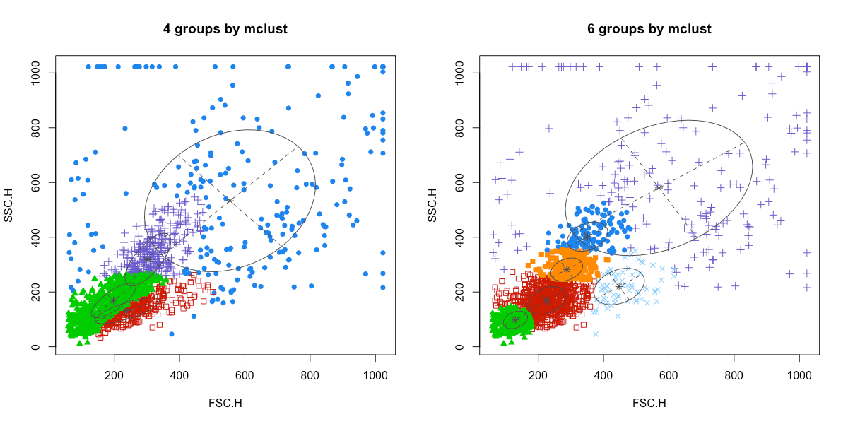
Model Based Clustering…
Notes:
Model based clustering t-distributions

Slide 10
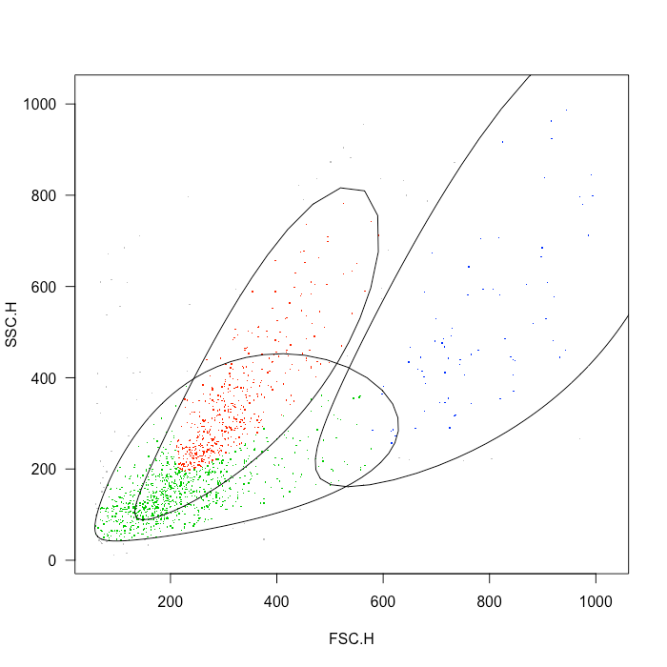
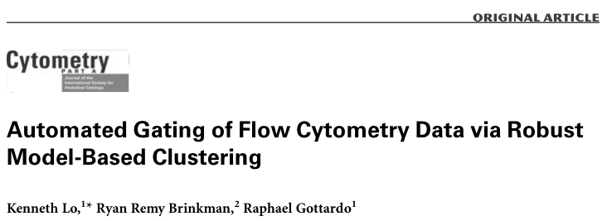
t-distribution Mixtures…
Notes:
Model based clustering t-distributions

Slide 11
Markov Random Fields…

Slide 12
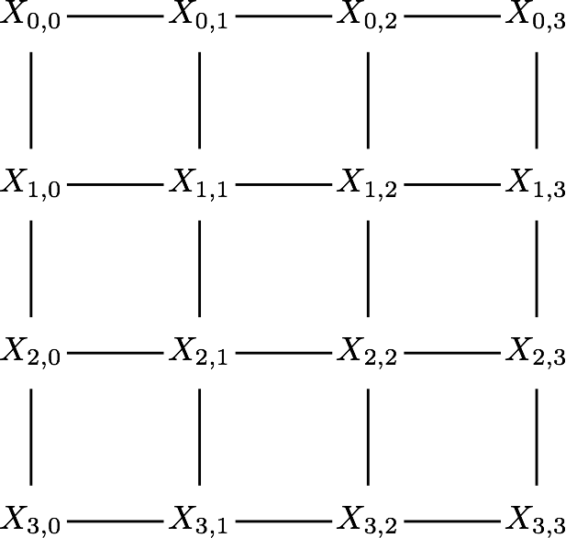

Slide 13
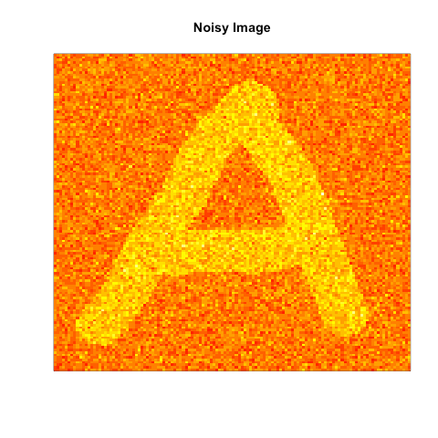
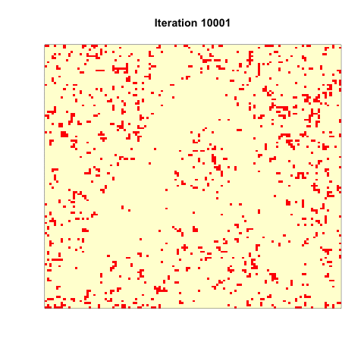

Working Example…

Slide 14
identifying clusters…

Slide 15
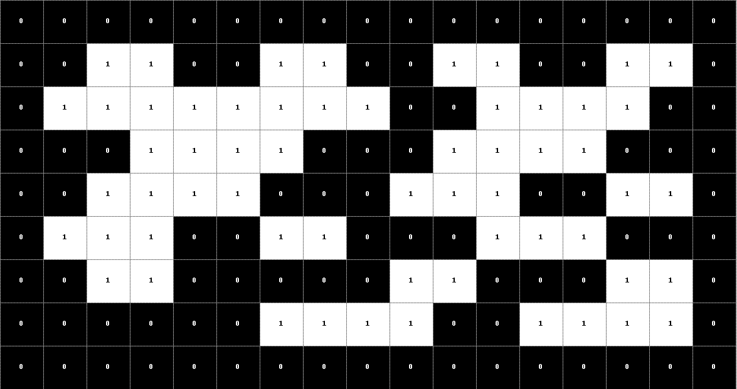

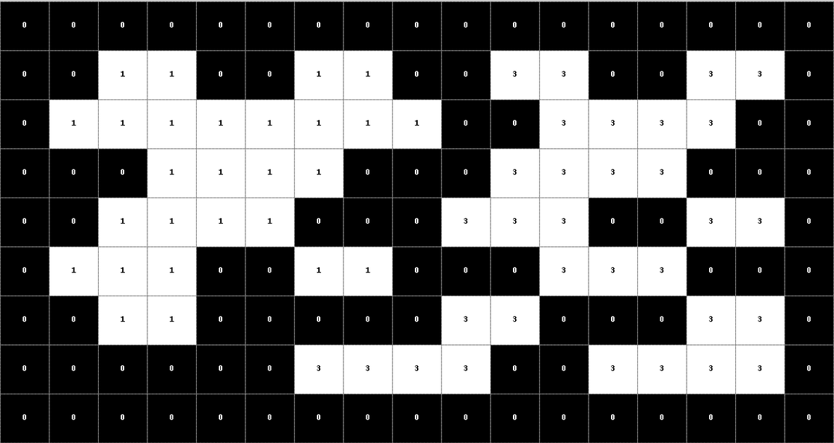
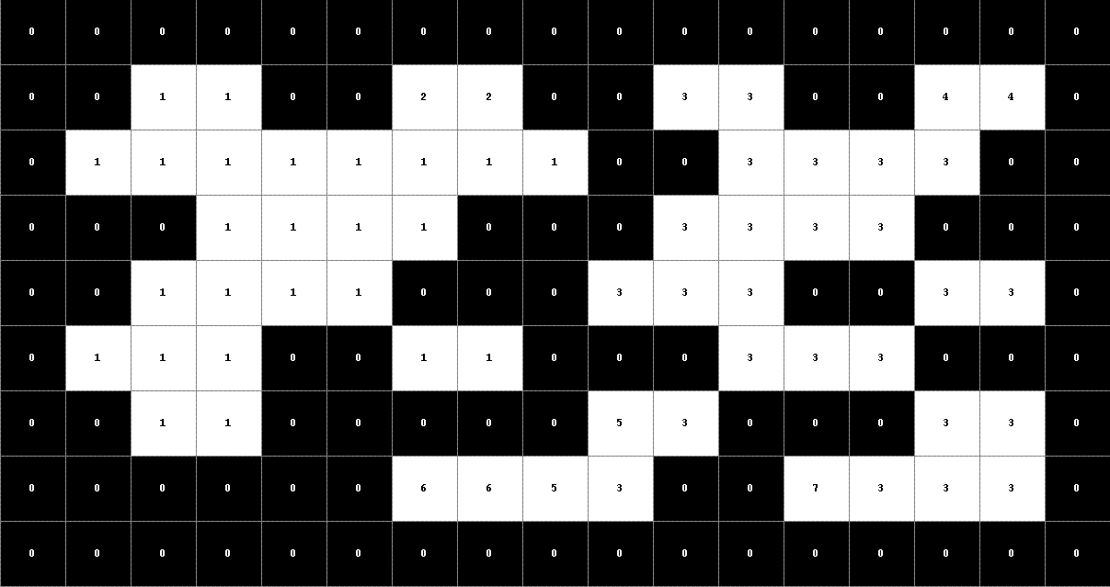
Connected-Components…

Slide 16
Results…

Slide 17
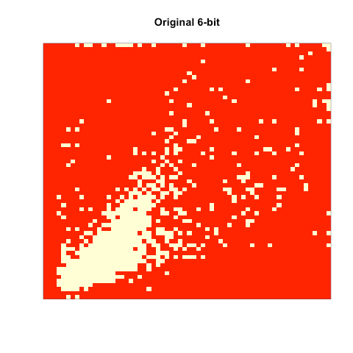
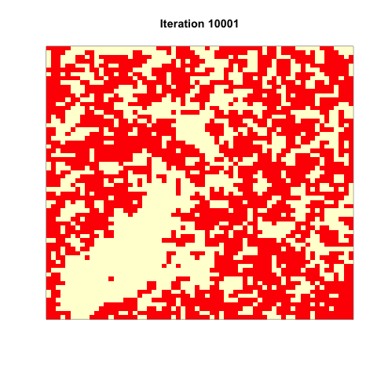
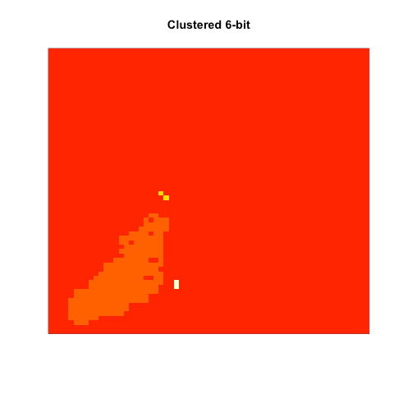

6-bit configuration…

Slide 18
Further Work…

Slide 19





Slide 20
Thanks for listening! any questions?

